Slide 1
Millimeter wave transmitter

Slide 2
Millimeter wave transmitter

Slide 3
Millimeter wave (MM wave), also known as millimeter band, is the band of spectrum with wavelengths between 10 millimeters (30 GHz) and 1 millimeter (300 GHz). It is also known as the extremely high frequency (EHF) band by the International Telecommunication Union (ITU).

Slide 4
Advantages of millimeter wave
Millimeter wave is a band of electromagnetic spectrum that can be used in a broad range of products and services, such as high-speed, point-to-point wireless local area networks (WLANs) and broadband access. In telecommunications, millimeter wave is used for a variety of services on mobile and wireless networks, as it enables higher data rates than at lower frequencies, such as those used for Wi-Fi and current cellular networks.
Propagation restrictions dictate the use of small cell sizes for Wi-Fi and cellular networks. The short propagation distance can increase the number of access points (APs) to cover a large area but also means fewer client devices will share the bandwidth in each cell. Small cells also facilitate the reuse of channels across the WLAN coverage area.
Antennas for millimeter wave devices are smaller than for other frequencies, making them more suitable for small internet of things (IoT) devices.

Slide 5
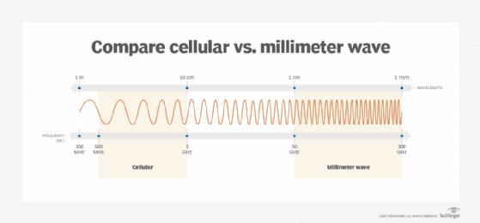

Slide 6
Disadvantages of millimeter wave
Millimeter waves are absorbed by gases and moisture in the atmosphere, which reduces the range and strength of the waves. Rain and humidity reduce their signal strength and propagation distance, a condition known as rain fade. The propagation distance at the lower frequencies is up to a kilometer, while the higher frequencies travel only a few meters.
A millimeter wave travels by line of sight and is blocked or degraded by physical objects like trees, walls and buildings. Its propagation is also affected by proximity to humans and animals, primarily due to their water content.

Slide 7
Millimeter wave uses
Millimeter wave has numerous uses, including telecommunications, short-range radar and airport security scanners. In telecommunications, it is used for high-bandwidth WLANs and short-range personal area networks (PANs). Its high bandwidth capacity is ideal for applications like short-distance wireless transmission of ultra-high definition video and communications from small, low-power IoT devices. The limited propagation distance -- small cell size -- and high data rates make millimeter wave ideal for communications between autonomous vehicles.
Portions of the millimeter wave bands are being used for the following use cases:
Institute of Electrical and Electronics Engineers (IEEE) 802.15 wireless PAN (WPAN);
IEEE 802.16 wireless metropolitan area network (WMAN), also known as WiMAX> (Worldwide Interoperability for Microwave Access);
IEEE 802.11ad multiple gigabit wireless system (MGWS) at 60 GHz; and
5G cellular telecommunications in the 24 GHz to 39 GHz bands.

Slide 8
Comparison with other spectrums
In comparison, Wi-Fi currently uses frequencies in the 2.4 GHz, 5 GHz and 6 GHz bands, which are known as microwave bands. Cellular networks use frequencies in the 600 MHz to 700 MHz and 2.5 GHz to 3.7 GHz bands. These bands propagate farther than millimeter wave but support lower bandwidths. Frequencies above millimeter wave are in the low infrared spectrum and are limited to short, line-of-sight communications.

Slide 9
References
https://www.techtarget.com/searchnetworking/definition/millimeter-wave-MM-wave

Slide 10
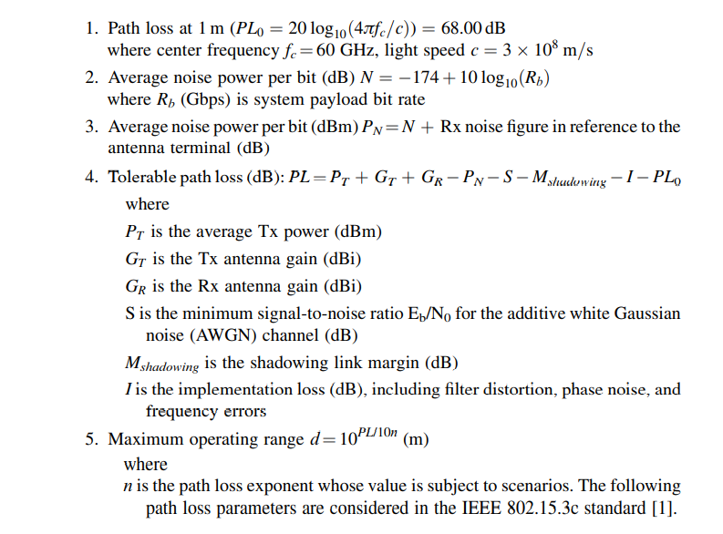
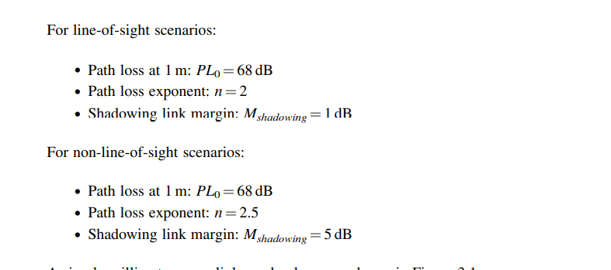
Millimeter wave transmitter

Slide 11
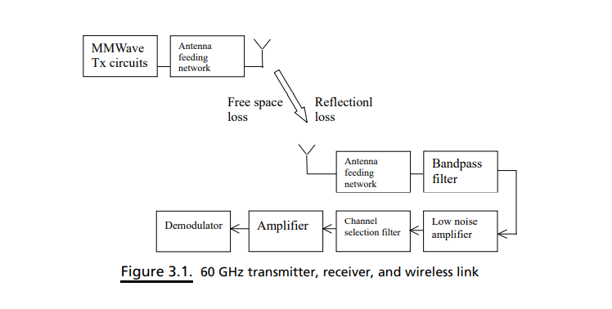
60 GHz Transmitter, receiver and wireless link

Slide 12
TRANSCEIVER ARCHITECTURE
Cost-effective millimeter wave solutions for high data rate transmission at 60 GHz still have to be determined. In this respect, some important selections have to be made that might be crucial to its commercial success:
Design of a 60 GHz radio front-end architecture.
Design of antennas
Employing a superheterodyne architecture
Employing a direct conversion architecture
Employing a software radio architecture
Employing a six-port technology

Slide 13
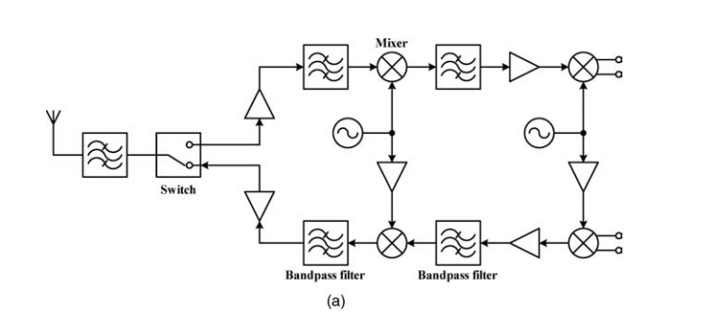
Super-heterodyning Architecture
This figure shows a basic 60 GHz RF front-end architecture for application at a portable station (PS).
Ideally, it should be an integrated on-chip solution consisting of a receiving branch, a transmitting branch, and a frequency generation function
The receiving branch consists of the receiving antenna, a low noise amplifier, and a mixer that down-converts the signal from the millimeter wave range to the intermediate frequency (IF) range.

Slide 15
Super-heterodyning Architecture
The transmitting branch consists of a mixer, a power amplifier (PA), and the transmitting antenna. The antennas are (integrated) patch antennas. The mixers are image rejecting mixers.
They need not to be in-phase/quadrature (IQ) mixers. The IF in this example is considered to be 5 GHz,
A super-heterodyning architecture requires more components and more DC power, so it is not preferred for mobile devices.
A radio receiver generally includes an antenna section filter, a low noise amplifier, a down-conversion mixer, an intermediate frequency stage, and a demodulator.
the antenna section filter receives RF-modulated signals and provides them to the low noise amplifier, which amplifies the received RF signals and provides the amplified RF signals of interest to the down-conversion mixer, which down-converts the frequency of the RF signals to an intermediate frequency using a local oscillator.
The IF stage includes one or more local oscillators, one or more mixers, and one or more adders to step down the frequency of the intermediate frequency signals to a base-band frequency. The IF stage provides the base-band signal to the demodulator which, based on the modulation/demodulation protocol, recaptures the data

Slide 16
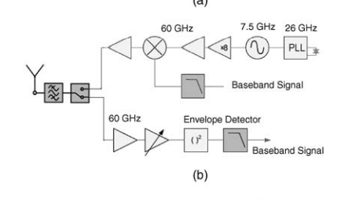
Direct Conversion Architecture
The challenge of this configuration is that a 60 GHz local oscillator is required.
Frequency shift keying (FSK)-modulated signals are especially well-suited to direct conversion, due to their low-signal energy at DC.

Slide 17
Limitations of direct conversion
The direct conversion receiver has not gained widespread acceptance to date, especially in high-performance wireless transceivers, due to its intrinsic sensitivity to the problems of DC offset, even harmonics of the input signal, and local oscillator (LO) leakage back to the antenna.
Offset arises from three sources
Transistor mismatch in the signal path
LO signal leakage to the antenna because of poor reverse isolation through the mixer and RF amplifier, which then reflects off the antenna and self-down-converts to DC through the mixer
A large near-channel interferer leaking into the LO part of the mixer, then self-down-converting to DC

Slide 18
Direct conversion
A block diagram of conventional millimeter wave direct conversion system with noncoherent on/off keying is shown in Figure 3.3(b).
OOK enables the simplest radio architecture to realize the lowest cost and fastest time to market.
It supports high rate applications (beyond Gbps) with very low power consumption due to its noncoherent architecture.
It has a sufficient performance over AWGN channels. Its phase noise of local oscillator has no effects on the detection performance

Slide 19
Soft radio
Employing analog-to-digital conversion (ADC) and digital-to-analog conversion (DAC) directly at the antennas would appear to make the complete RF and IF portions of the transceiver chain obsolete.
However, this technology is extremely challenging because it would require ultra-high speed ADC and DAC devices having a 60 GHz bandwidth.
A low-cost implementation of this in the medium term is not feasible. An alternative approach, the subsampling receiver, might represent the “ultimate” solution for simple, low power, down-conversion
This essentially consists of a sampling switch, clocked at a much lower frequency, and an analog-to-digital (A/D) converter.
As a result, careful filtering is required prior to down conversion. For example, the down conversion of an RF signal with a bandwidth of 500 MHz would require a sample rate of at least 1 GHz, assuming the use of a “brick wall filter.”
In practice, the sampling rate will have to be much higher, for example, at least 2 GHz, in order to minimize the finite bandwidth effects of the filter. It is questionable whether 2 GHz A/D conversion, with, let us say, 10 bit quantization, will become feasible and low cost in the medium term.
In addition, the problem exists that the resulting signal-to-noise ratio of the down-sampled signal will inevitably be poorer than that of an equivalent system employing a mixer for down conversion. This is due to the noise aliased from the bands between DC and the passband

Slide 20
Transceiver without mixer
No mixer transceiver refers to a six-port radio that uses no mixers in transceivers.
Six-port technology (or five-port technology) is a passive linear device, with two input ports and three outputs (see Figure 3.6) .
A phase shifter is used to adjust the phase between the RF and LO.
Diode detectors are used on the output ports as frequency converters, instead of mixers.
The five-port technology has been extended to be a direct digital transmitter and can be used for software-defined radio applications since it can accommodate different wireless modulation standards without requiring hardware modification

Slide 21
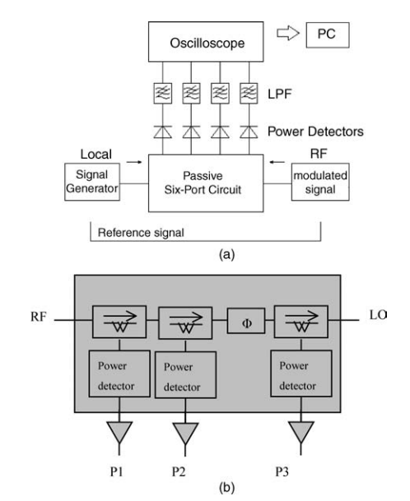
Transceiver without mixer
A six-port radio’s modulator performs analog signal processing (vector divisions and additions) on reflected spectrum phase-modulated pulse waves using the phase spectrum of reference pulse waves.
The six-port radio’s demodulator does the reverse analog signal processing to directly obtain data with a decoder (analog or digital) from interferometer output signals
Block diagram of six-port radio with four interferometer output power signals. (b) Block diagram of a five-port radio

Slide 22
Transceiver without mixer
The changes made in the six-port radio are summarized below
The reference signal and modulated signal (or unknown signal) are fed to different input ports in the six-port interferometer radio. The modulated signal can be a single carrier or multiple carrier signal.
A new PSMS is introduced. The PSMS phase modulates digital data on the entire phase spectrum of a monocycle pulse, on a single frequency carrier, or on multiple carriers. This modulation allows the unique six-port radio hardware to be utilized for communications.
The following features can be tested in a six-port radio for quadrature phase shift keying (QPSK)/binary phase shift keying (BPSK):
Development of a new modulator circuit to realize PSMS
Development of a simple, fast decoder (analog or digital) for the receiver to obtain output signals from the interferometer’s demodulation of digital data transmitted by wired or wireless.

Slide 23
Development of digital signal processing (DSP) algorithms for PSMS modulation schemes and PSDS demodulation schemes.(phase spectrum modulation/demodulation)
Demonstration of wired and wireless (with phase linear antennas) digital data transmission in a laboratory environment.
Unique six-port radio (hardware and software) is used for broadband communications
The six-port radio platform contains two six-port interferometers (one for modulation and the other for demodulation), a four-channel digital signal processor, four single-pole double-throw (SPDT) switches, two antennas (Rx/Tx), and various minor components, such as wideband, short, and open circuit terminations.
Six-port radio technology provides cognitive radio hardware and software at a low cost and with wideband/narrow-band performance, along with integrated chips for QPSK/BPSK data transmissions. Promising means are also available to extend the present six-port radio to include QAM/MPSK data and other digital formats.
Six-port radios can operate in multimedia user environments with a central radio provider to serve military, commercial, and consumer software needs. The calibration process plays a key role in the six-port communication system.
It is done periodically online to avoid tuning procedures and to decrease quality control costs. An efficient calibration process can improve the speed of six-port radios [23]. Six-port radios are designed to operate in wideband channels (over 500 MHz per channel), and in wideband single/multiple carrier communication systems, for example, orthogonal frequency division multiplexing

Slide 24
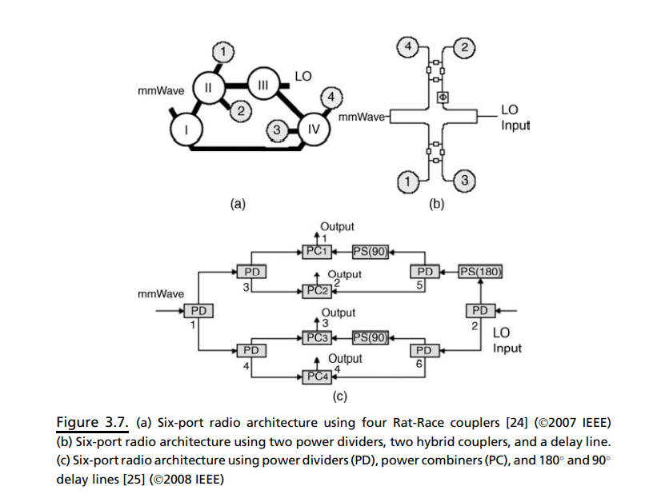
Demodulators –Six port with passive circuits

Slide 25
Demodulators –Six port with passive circuits
Figure 3.7(a) shows an example of a six-port circuit composed of four Rat-Race couplers and connected by 50 V microstrip transmission lines
The Rat-Race couplers are four-port devices used to either equally split an input signal or to combine two signals.
An additional benefit of the hybrid ring is to alternately provide equally split but 180 phase-shifted output signals.
This four-coupler configuration creates a lossless device with low VSWR (voltage standing wave ratio), excellent phase and amplitude balance, high output isolation, and matched output impedances.
The low-loss airline construction also makes the device a perfect choice for combining high-power mixed signals.
The incident waves, millimeter wave input, and LO signals are applied to the couplers I and III, respectively. The couplers (I, II) and (II, III) are connected by a transmission line length of 0.25 λ, the couplers (I, IV) by λ, and the couplers (III, IV) by 0.5 λ

Slide 26
The phases of S51 and S52 are equal as well as phases of S53 and S54. Ports (1, 2) and ports (3, 4) are 90 out of phase over a very wide band, suitable for a high-quality I/Q (in-phase/quadrature-phase) mixer

Slide 27
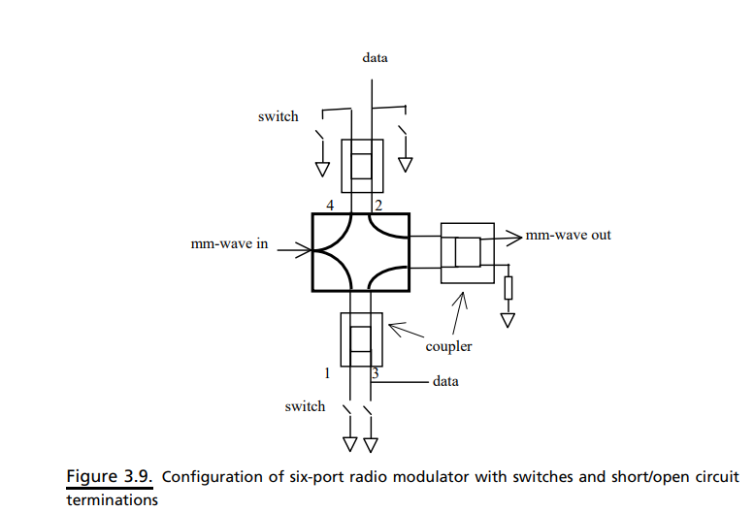
Modulators –Six port with passive circuits

Slide 28
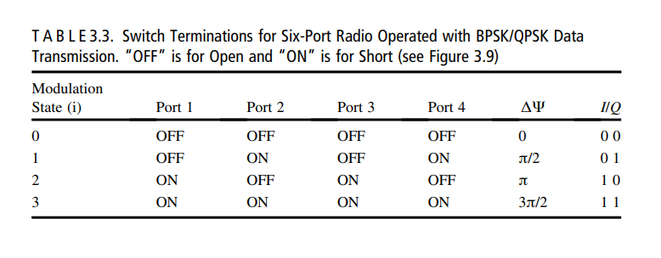
Modulators
Figure 3.9 shows a drawing of a modulator with switches and output terminations (shorts or open circuits) for BPSK/QPSK modulation
Terminal circuit shorts provide reflection coefficients (k=1), and terminal open circuits also provide reflection coefficients (k=-1).
Lossless passive circuits, with the required reflection coefficients, can be designed as terminations, to act with fast switches and operate a modulator at the desired high rate for QPSK/BPSK data

Slide 29
Receiver without Local Oscillator
In a millimeter wave system, millimeter wave LOs are costly and consume much more DC power than other RF local oscillators.
If a millimeter wave receiver can be built without using an LO, the system will save DC power and the cost for the system will be reduced.
Such a method and apparatus include the process that begins by generating a charge signal, a data acquisition signal, and a reset signal from an I component and a Q component of an FSK-modulated signal.
This process continues by generating a delta frequency signal based on the charge signal, the data acquisition signal, and the reset signal.
The delta frequency signal is representative of the frequency difference used within the FSK modulation to differentiate between a logic “1” and a logic “0”. The process then demodulates the delta frequency signal to recapture a stream of data

Slide 30
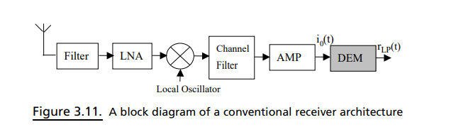
Conventional FSK-demodulator
Figure 3.11 shows a conventional receiver architecture, which includes an antenna for the reception of transmitted signals. The antenna is connected to a mixer via an RF-bandpass filter and a low-noise-amplifier (LNA).
The mixer multiplies the signal received by the antenna using a signal generated by a local oscillator to down convert the signal to an intermediate frequency (IF).
The IF signal travels from the mixer, via a channel selection filter and another amplifier, to a conventional FSK demodulator (DEM).
The FSK demodulator receives the FSK input signal i0(t). The differential FSK demodulator demodulates the FSK input signal i0(t) and outputs a low-pass filtered signal rLP(t).

Slide 31
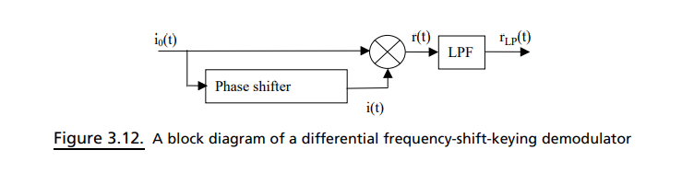
Differential FSK demodulator
Figure 3.12 shows the internal structure of a differential FSK demodulator. It consists of a phase shifter, a mixer, and a low-pass filter.
The input signal i0(t) is supplied to both the phase shifter and the mixer. The phase shifter shifts the phase of the input signal i0(t) by a predetermined number of degrees and outputs a shifted signal i(t) to the mixer.
The mixer multiplies the input signal i0(t) by the shifted signal i(t) and outputs a mixed signal r(t) to the low-pass filter.

